Slide 1
CAR OBJECT DETECTION USING YOLO V5
DONE BY,
A.VIGNESH
REG.NO:912321104053
SACS MAVMM ENGINEERING COLLEGE,MADURAI

Slide 2
PROJECT COVERS:
Problem statement
Proposed system/solution
System development approach
Algorithm and deployment
Result
conclusion

Slide 3
PROBLEM STATEMENT
Develop a robust car object detection system capable of accurately identifying and localizing cars in images or video streams. The system should be able to handle various environmental conditions such as different lighting conditions, weather conditions, and varying car orientations and sizes. The goal is to create a solution that can be used for applications like traffic monitoring, parking management, and autonomous driving assistance systems. Key objectives include high detection accuracy, real-time processing capability, scalability, and adaptability to different camera setups and perspectives.

Slide 4
PROPOSED SYSTEM/SOLUTION
1. Deep Learning Model:
Implement a deep learning-based object detection model such as YOLO (You Only Look Once), Faster R-CNN (Region-based Convolutional Neural Network), or SSD (Single Shot MultiBox Detector).
These models are known for their accuracy and efficiency in object detection tasks.
2. Dataset Preparation:
Collect and curate a diverse dataset containing a wide range of car images in different environments, lighting conditions, weather scenarios, and perspectives.
The dataset should include annotated bounding boxes for each car instance.
3. Data Preprocessing:
Preprocess the dataset by performing data augmentation techniques such as random scaling, rotation, flipping, and brightness adjustments.
This step helps in enhancing the model's robustness and generalization capabilities.
4. Model Training:
Train the deep learning model using the preprocessed dataset.
Fine-tune the model's hyperparameters and architecture to optimize performance metrics such as detection accuracy, speed, and memory efficiency.

Slide 5
PROPOSED SYSTEM/SOLUTION(CONTD…)
5. Deployment:
Deploy the trained model on suitable hardware platforms for real-time inference.
Utilize GPU acceleration for faster processing speeds, especially in applications where low latency is critical, such as autonomous driving systems.
6. Post-processing Techniques:
Implement post-processing techniques such as non-maximum suppression (NMS) to refine the detected bounding boxes and eliminate duplicate or overlapping predictions.
7. Integration with Camera Systems:
Integrate the car object detection system with camera systems such as CCTV cameras, dashcams, or onboard vehicle cameras.
Ensure compatibility and optimize performance for the specific camera setups and resolutions.
- By following these steps and implementing the proposed system, a robust and efficient car object detection solution can be developed to address various use cases in the automotive industry and related domains.

Slide 6
SYSTEM DEVELOPMENT APPROACH
The development of a robust car object detection system involves a systematic approach starting with a thorough analysis of the system's requirements and objectives.
This includes understanding the target environment, deployment platform, performance metrics, and integration needs.
The next step is to collect a diverse dataset of car images or video frames and annotate them with bounding boxes for training the chosen deep learning-based object detection model.
Data preprocessing techniques such as data augmentation are applied to enhance the model's generalization and robustness.
The model is then trained, fine-tuned, and validated using separate datasets to optimize detection accuracy and speed
Post-training optimizations are performed to ensure efficient deployment on the target hardware platform, and integration with camera systems is facilitated to accommodate various camera setups and resolutions.
Continuous monitoring, maintenance, documentation, and user training are essential components to ensure the system's reliability, performance, and usability over time.

Slide 7
.
SYSTEM DEVELOPMENT APPROACH(CONTD…)
This is a process for vehicle detection using image processing techniques and pre-trained classifiers. It employs various steps to identify and mark both cars and buses within images.
The process begins with downloading, resizing, and converting the images to a format suitable for analysis.
Then, a series of operations are applied, such as grayscale conversion, Gaussian blur, dilation, and morphological closing, to enhance object detection.
The code utilizes OpenCV’s CascadeClassifier to detect cars and buses, marks them with colored rectangles, counts the detections, and finally displays the annotated images.

Slide 8
AGLORITHM AND DEPLOYMENT
1. Single Shot Detector (SSD)→
IntroductionThe single-shot detector for multi-box predictions is one of the fastest ways to achieve the real-time computation of object detection tasks.
While the Faster R-CNN methodologies can achieve high accuracies of prediction, the overall process is quite time-consuming and it requires the real-time task to run at about 7 frames per second, which is far from desirable.
The single-shot detector (SSD) solves this issue by improving the frames per second to almost five times more than the Faster R-CNN model.
2. YOLO (You Only Look Once)→
IntroductionYou only look once (YOLO) is one of the most popular model architectures and algorithms for object detection. Usually, the first concept found on a Google search for algorithms on object detection is the YOLO architecture.
There are several versions of YOLO, which we will discuss in the upcoming sections. The YOLO model uses one of the best neural network archetypes to produce high accuracy and overall speed of processing.
This speed and accuracy is the main reason for its popularityThe YOLO architecture utilizes three primary terminologies to achieve its goal of object detection.

Slide 9
ALGORITHM AND DEPLOYMENT(CONTD…)
The first concept in the YOLO model is residual blocks. In the first architectural design, they have used 7×7 residual blocks to create grids in the particular image.
Each of these grids acts as central points and a particular prediction for each of these grids is made accordingly. In the second technique, each of the central points for a particular prediction is considered for the creation of the bounding boxes.
While the classification tasks work well for each grid, it’s more complex to segregate the bounding boxes for each of the predictions that are made.
The third and final technique is the use of the intersection of union (IOU) to calculate the best bounding boxes for the particular object detection task.
To develop a car object detection system, several key steps must be followed. First, a diverse dataset containing images of cars alongside accurate labels, such as bounding boxes or segmentation masks, must be collected and annotated.
Next, a suitable model architecture needs to be chosen, with options like YOLO, Faster R-CNN, or SSD being popular choices. This model should then be fine-tuned using the collected dataset to ensure optimal performance.
Subsequently, the model undergoes training using a split dataset for training and validation, employing appropriate loss functions and monitoring performance metrics like precision, recall, and mAP. Once the model is trained and evaluated satisfactorily, it needs to be deployed.

Slide 10
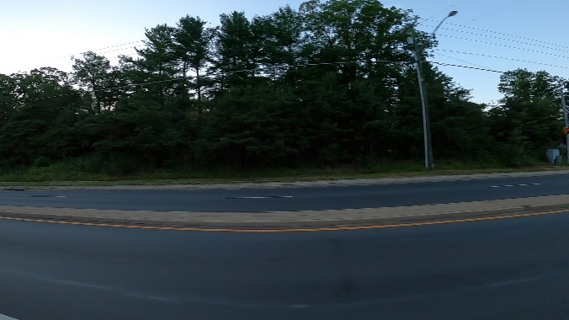
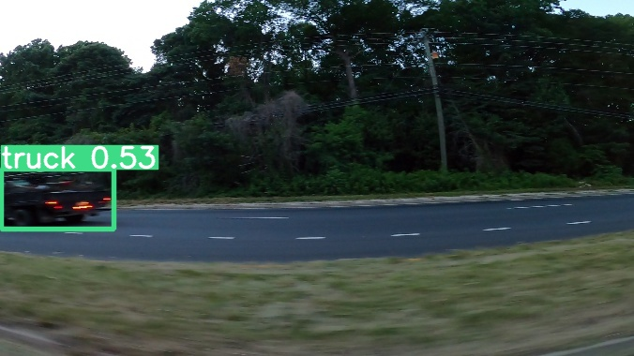
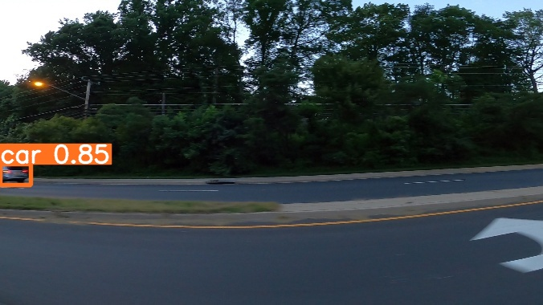
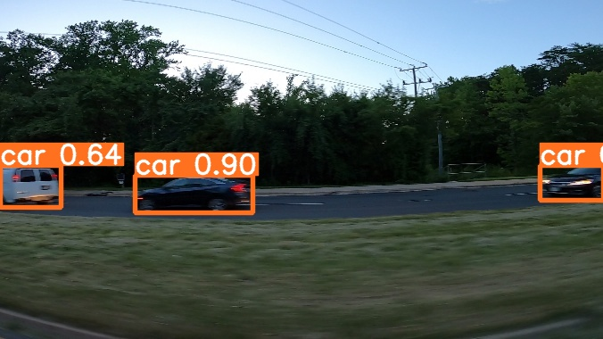
RESULT
The result of a car object detection system is its ability to accurately identify and locate cars in images or videos by outlining them with bounding boxes or masks. This output is useful for applications like traffic monitoring, autonomous driving, or security surveillance, evaluated based on metrics like accuracy and precision.

Slide 11
.
REFERENCE
https://medium.com/@kaanerdenn/introduction-to-object-detection-vehicle-detection-with-opencv-and-cascade-classifiers-8c6834191a0b#:~:text=This%20is%20a%20process%20for,a%20format%20suitable%20for%20analysis
https://www.researchgate.net/figure/Main-workflow-of-the-proposed-vehicle-counting-approach_fig1_332631701
https://colab.research.google.com/drive/1B2dmUMnQB7GGI7km8fUcavw1O7STO8a
https://www.kaggle.com/code/advaypatil/car-object-detection
Dataset Link:
https://www.kaggle.com/datasets/sshikamaru/car-object-detection

Slide 12
CONCLUSION
In conclusion, car object detection is a crucial technology with widespread applications in various fields such as autonomous driving, traffic management, surveillance, and more. Through the use of advanced algorithms and deep learning techniques, accurate and efficient detection of cars can be achieved, contributing significantly to safety, efficiency, and innovation in transportation and related industries. Continued research and development in this area promise further improvements in accuracy, speed, and robustness, making car object detection an indispensable component of the modern technological landscape.

